Slide 1


Weather Station
PROJECT
DHRUVBHATTACHARJEE
NITIN MISRA
Mentor : Charanpreet Ma’am
Project Teacher : Mohit Sir
18BCS2072
18BCS1988

Slide 2
INTRODUCTION:
The Weather Station which will be used to analyze data to weather and also to notify for rainfall to take a action by closing or opening windows and door.

Slide 3
RESOURCES:
Hardware requirements:
• Arduino Uno
• DHT11 Temperature and Humidity sensor
• Raindrop detection sensor
• ESP8266 WIFI module
• GSM module for Arduino
• Internet enabled WIFI connection
• Computer (programming Arduino)
Software requirements:
• Window/Linux/Mac OS
• Arduino IDE
• Python
• Eclipse mosquitto
• MongoDB
• Google cloud services

Slide 4
Completion of Project
The Project is 50% completed on time as the target set.
The connection with Arduino and Working of sensors were tested
The pending of connection of Wifi to mosquitto and database would be completed further.

Slide 5
SOFTWARE AND BACKEND control
The main Programming part is to be implemented for and on the Arduino as the main device.
The frontend As mentioned before we use Adruino IDE as the corntol center for themain IoT device Aduino.
The Backend used in this is mongoDB. MongoDB is a source-available cross-platform document-oriented database program. It stores and helps to provide data for the prediction of the weather.
One more front end part that can be termed as the User interface will be managed by Eclipse mosquito. It will be used to show the readings.
Following are the Screenshots of the control centre for the project

Slide 6
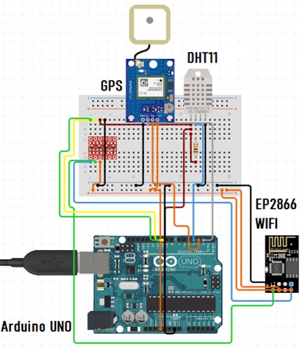
CIRCUIT:
The components of the circuit given are as follows:
DHT11 as the main sensor
WIFI Module
Arduino UNO
Raindrop sensor

Slide 7
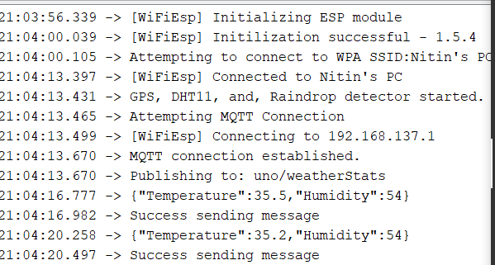
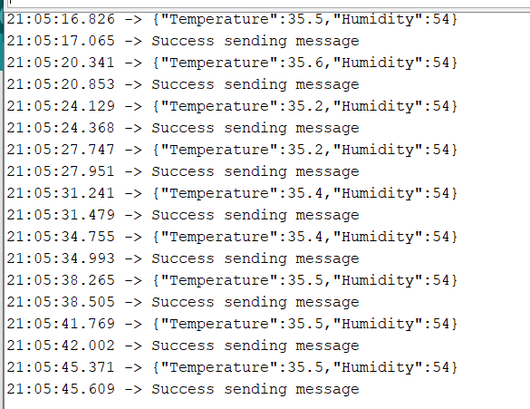
Wi-Fi connection with mosquitto

Slide 8
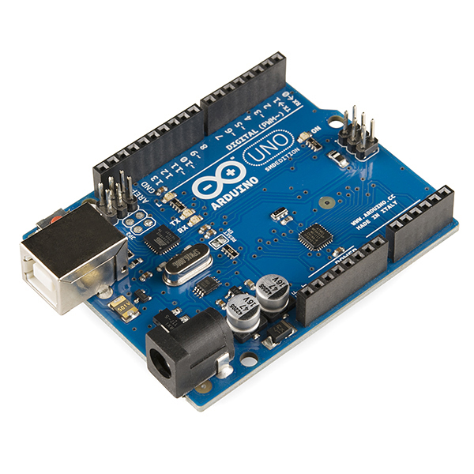
ADRUINO UNO
Arduino is an open-source hardware and software company, project and user community that designs and manufactures single-board microcontrollers and microcontroller kits for building digital devices.
This will be used to trigger and use the different components.
Just like IOT, such a main device will be used to activate and bring in use the other components connected to it.

Slide 9
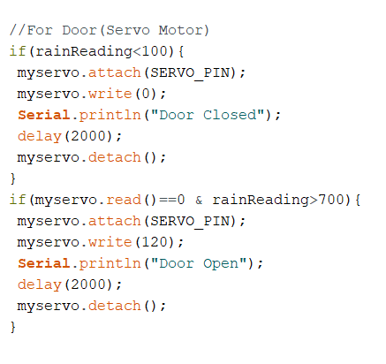
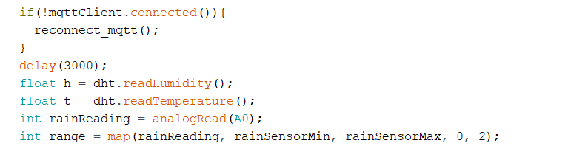
Code work for connection of The Rain drop sensor and DHT11

Slide 10
THANK YOU

